Slide 1
Designing Experiments, ANOVA and Correlation Coefficients Biology 683 Lecture 6 Heath Blackmon

Slide 2
Last week
How do you choose the number of permutations to run?
Which t-test doesn’t assume the variables being studied have a normal distribution in the population?

Slide 3
Semester
Binomial, Chi-Square
Bayes Theorem
T-tests (one sample, two sample, paired)
Permutation and other non-parametric options
ANOVA and non-parametric options
Correlation and Covariance
Midterm – Next week Tuesday review and practice, Thursday test.
GLMs x 2
Monte Carlos
Dimensional reduction
Phylogeny
Plotting
Reproducible workflows
Final
language (parameter, data, statistic, p-value, etc.)
Reproducibility crisis
Frequentist vs Bayesian
Basic plotting
Readable code
Types of replication

Slide 4
Today
Experimental design
ANOVA
Correlation and Covariance

Slide 5
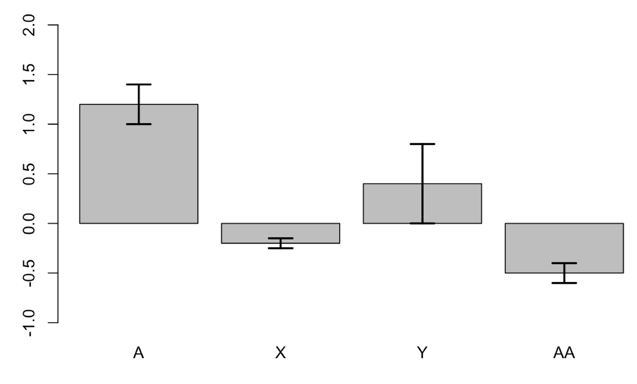
Statistical Significance versus Biological Importance
A p-value is not a sufficient description of the effect of a treatment or variable
Even very small effects can be shown to be highly statistically significant with large enough sample sizes
This issue is especially problematic in the new era of big data (GWAS, Expression studies)
*
*
*

Slide 6
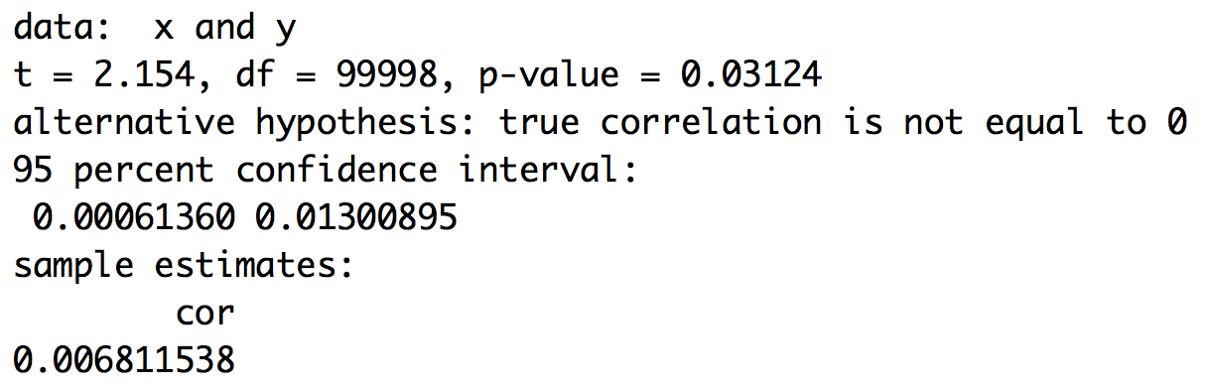
Statistical Significance versus Biological Importance

Slide 7
Effect size!
Statistical significance is not enough – you also need to calculate and report the magnitude of the effects. If the effect is exceedingly small, then it might not be interesting. Biological significance can only be determined in light of the system under study.
Why is this important in basic research / applied research?

Slide 8
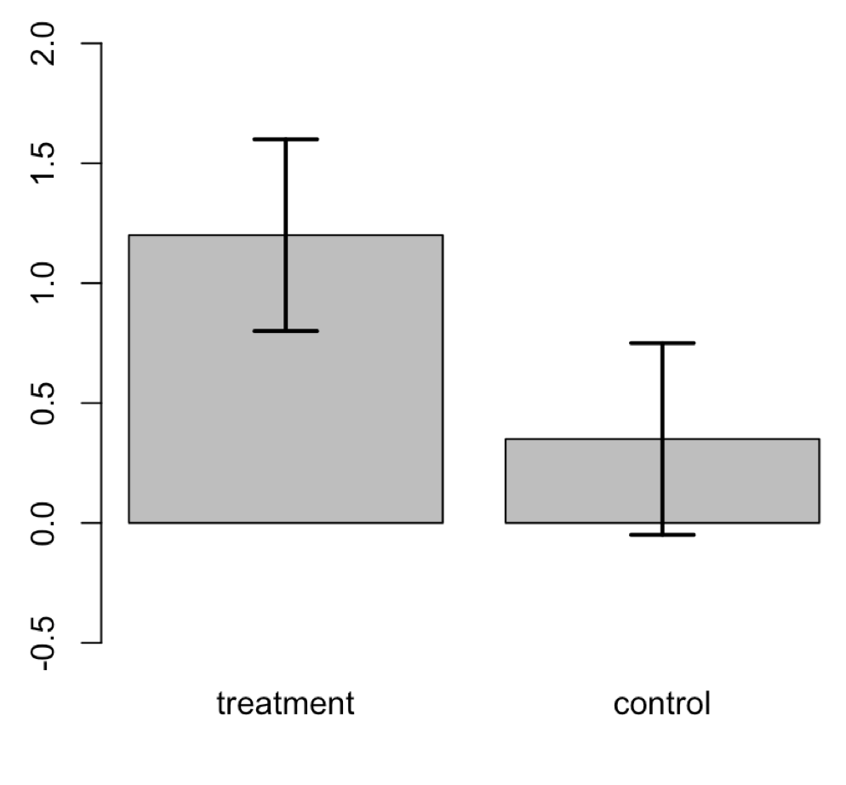
Common mistake
The treatment is significantly different from zero
The control is not significantly different from zero
So… the treatment must be different from the control, right?
No. You must directly compare the treatment to the control. Lots of possible reasons for control not to be zero!

Slide 9
Designing Experiments
Some considerations we’ve already discussed:
Confounding variables
Experiment bias
Multiple control groups
Randomization
Single-blind and double-blind experiments

Slide 10
Some New Concepts
Balance
A balanced design has an equal sample size in each treatment and control group – balanced designs have the most power.
Blocking
Similar to a paired, but possibly with multiple treatments and controls. Example on next slide.
Extreme Treatments
By using extremely high values of the treatment, we might be able to show an effect. We would have to consider whether these extreme values have biological relevance
Factors
A factor is a single treatment variable whose effects are of interest. An experiment can have more than one factor (light and humidity, for instance, would be two different factors). We sometimes wish to test multiple factors simultaneously, because they might interact

Slide 11
Block what you can, randomize what you cannot.
Shelf 1
Shelf 2
Shelf 3
Shelf 4
Treatment A
Treatment B
Treatment C
Treatment A
Control
Treatment C
Treatment B
Control
Treatment C
Control
Control
Treatment B
Treatment B
Treatment A
Treatment A
Treatment C
What is being blocked?
What is being randomized?
What else might we randomize?

Slide 12
Example of Multiple Factors
An experiment has multiple factors when you are interested in the effects of more than one variable.
An example might be the role of genotype and environment on growth rate.
Imagine there are two strains and you want to test their growth in two environments.
A factorial design would require testing each strain in each environment for a total of four treatments
This experiment would be called a full factorial design

Slide 13
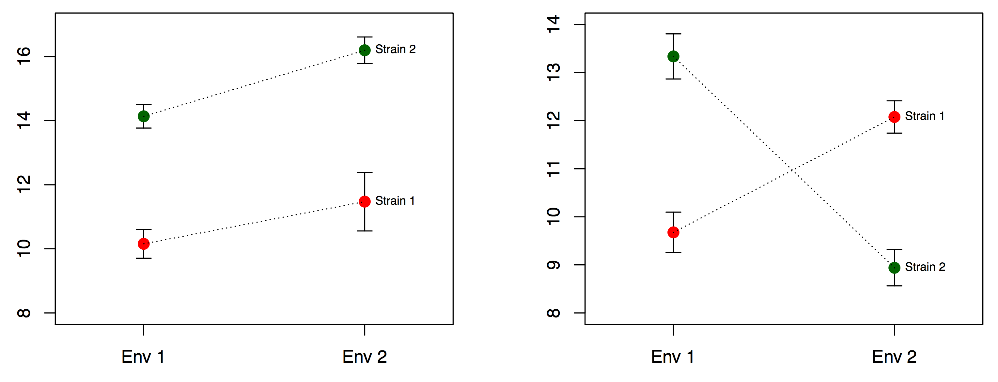
Multiple factors and interactions

Slide 14
Precision
It is possible to plan your experiment to achieve a desired level of precision
The catch is that you have to know something about the expected standard deviation of your response variable
The other catch is that you will often find the sample sizes needed to be shockingly high

Slide 15
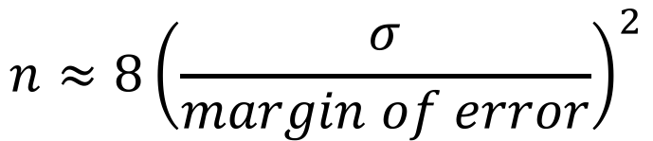
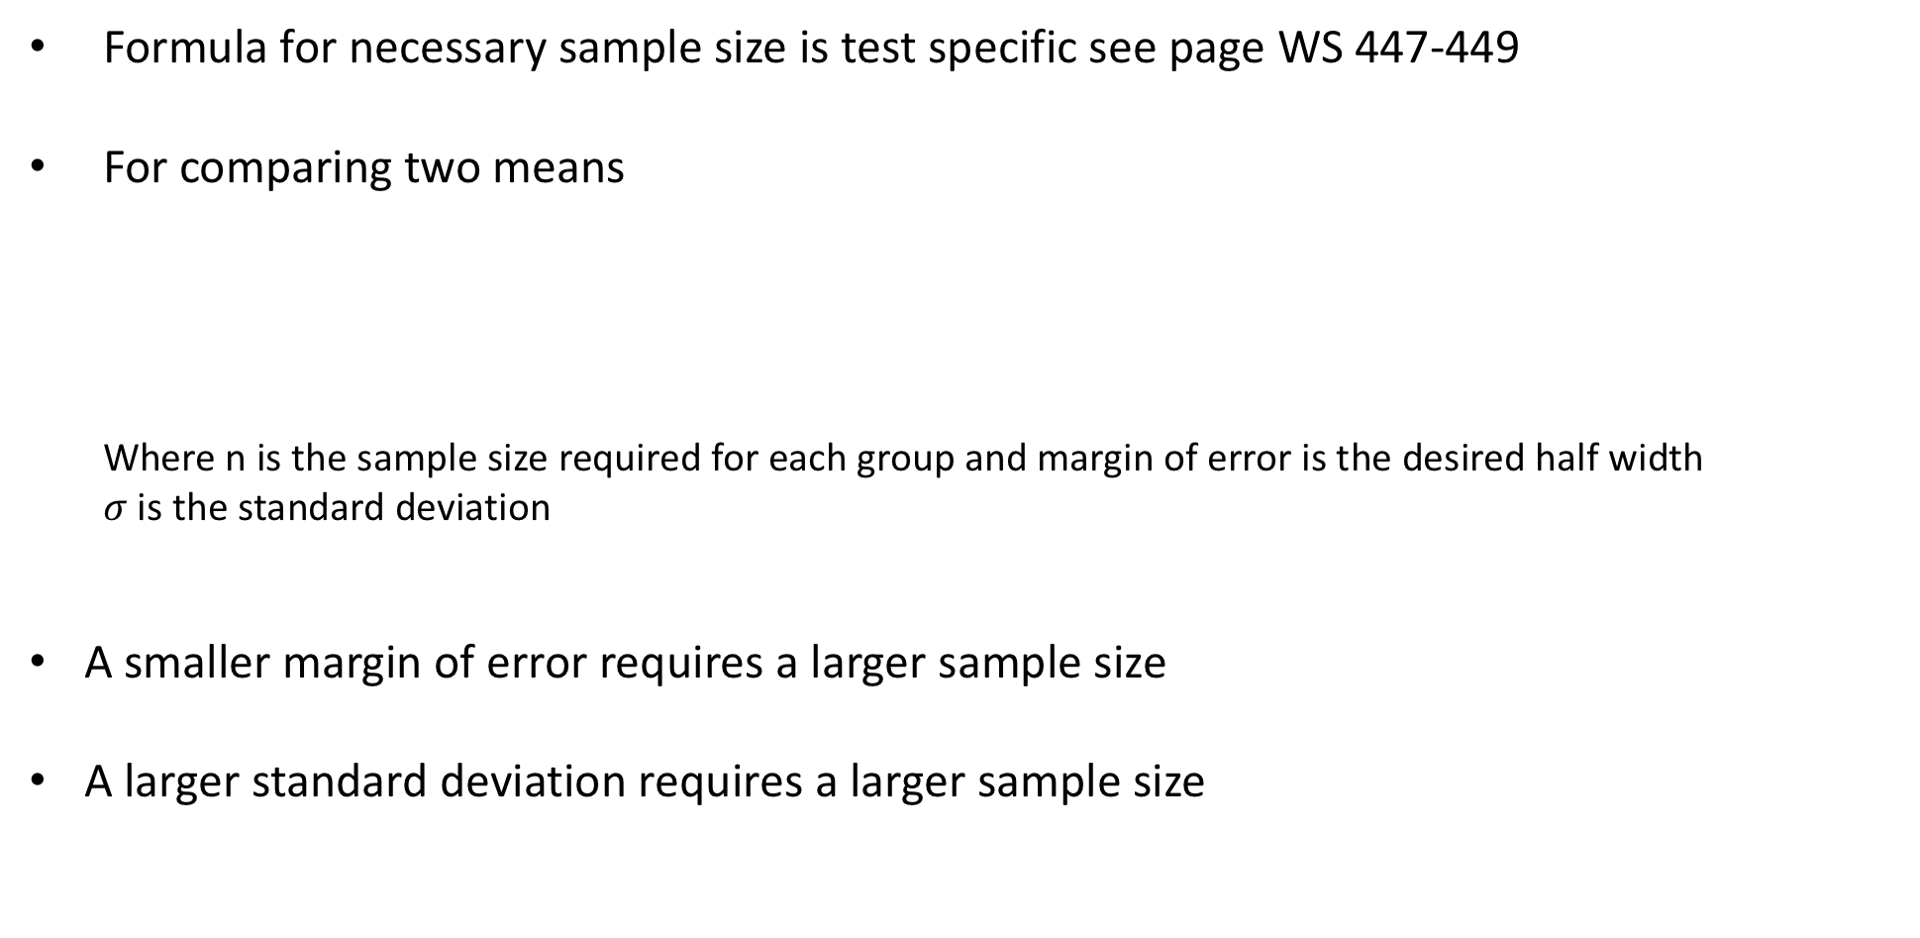
Precision
Formula for necessary sample size is test specific see page WS 447-449
For comparing two means
Where n is the sample size required for each group and margin of error is the desired half width
$σ$ is the standard deviation
A smaller margin of error requires a larger sample size
A larger standard deviation requires a larger sample size
$$n≈8{\left(\frac{σ}{margin of error}\right)}^{2}$$

Slide 16
Power
A more useful and common way to estimate the necessary sample size is to focus on power
Power: the probability of rejecting the null hypothesis for a hypothesized difference in means
Power calculations are often necessary
When you fail to reject the null, was it because you had insufficient power to detect a reasonable departure?
When you apply for a grant or institutional approval, the agency often wants to know that your experimental design will have the power to detect a difference if one exists.

Slide 17
Calculating Power
Imagine an experiment testing the difference between two means in an unpaired design
The appropriate test is a two-sample t-test
Example:
A 6 week old chick weighs around 250 grams, s.d. around 50
Feeding them a supplement results in about a 10-20 percent increase in weight at 6 weeks.
What sample size would I need to detect an effect of a supplement (i.e., reject the null hypothesis that it has no effect)

Slide 18
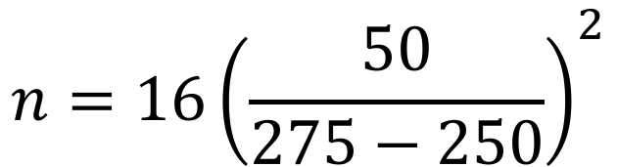
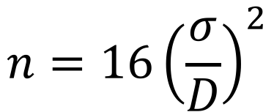
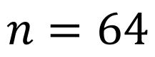
Power for a Two-sample t-test
For a power of 0.8 (i.e., an 80 percent chance of rejecting the null hypothesis when it’s not true), I need a sample size of:
$$n=16{\left(\frac{σ}{D}\right)}^{2}$$
D is the expected difference in means.
$$n=16{\left(\frac{50}{275−250}\right)}^{2}$$
$$n=64$$
For each treatment

Slide 19
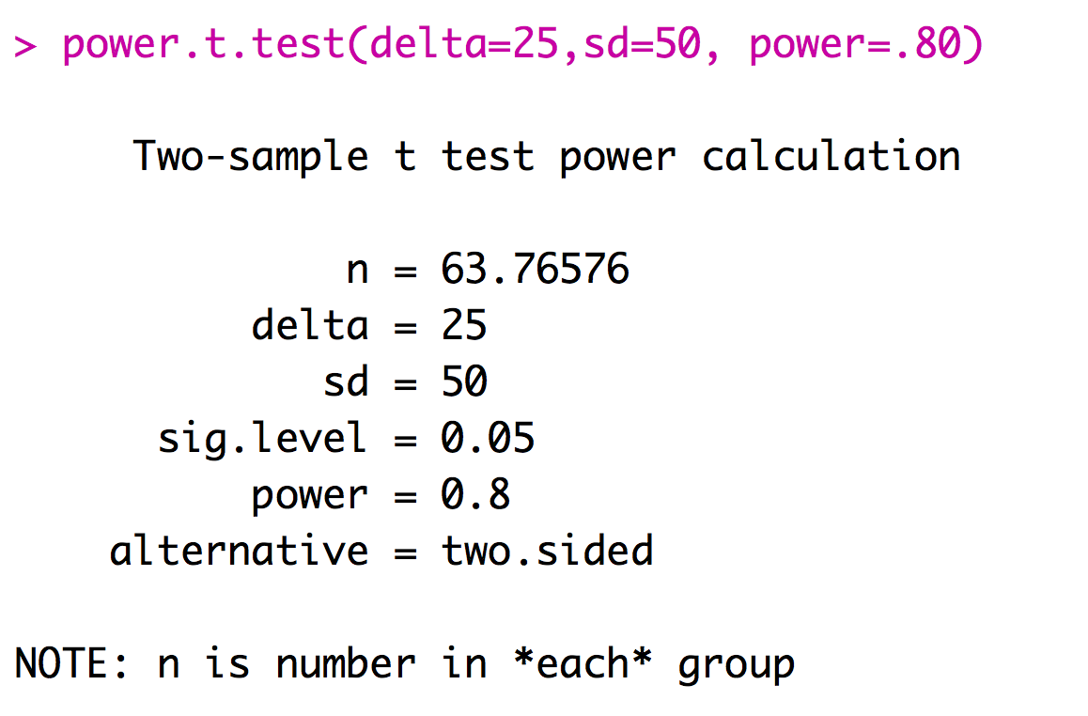
Power for a Two-sample t-test

Slide 20
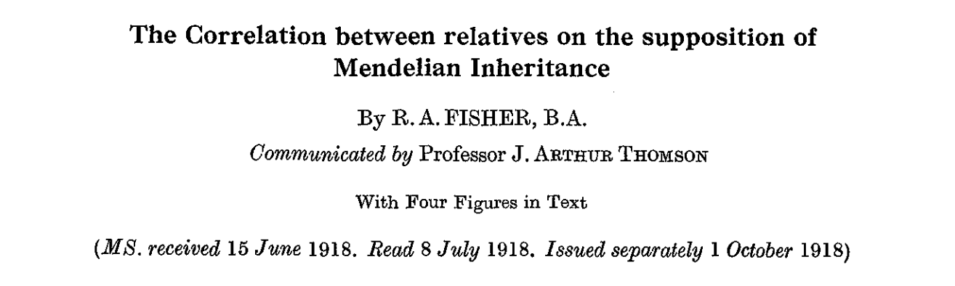
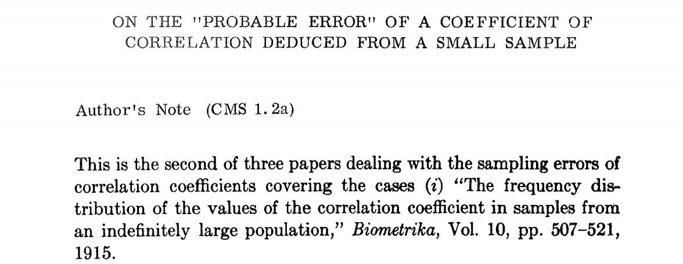
Fisher
R. A. Fisher
Already heard about “Fisher’s Exact Test” Among many other contributions, Fisher also invented analysis of variance and the F-distribution
He also was one of the figures in the Modern Synthesis – reconciling the facts of genetics with the idea of natural selection.
Popularized the p <= 0.05 as general rule of thumb (not a hard fast rule as applied today)
FYI he was a firm believer in eugenics, racist, and spoke against inference that smoking caused cancer.

Slide 21
Analysis of Variance
Used to compare the means among more than two groups
If you are comparing three groups, for instance, you cannot just do three pair-wise t-tests – this approach would cause too many false positives
ANOVA takes into account the fact that you are comparing multiple groups and controls the false positive rate.

Slide 22
Analysis of Variance
A | B | C
2 | 5 | 7
2 | 8 | 4
3 | 8 | 5
5 | 7 | 4

Slide 23
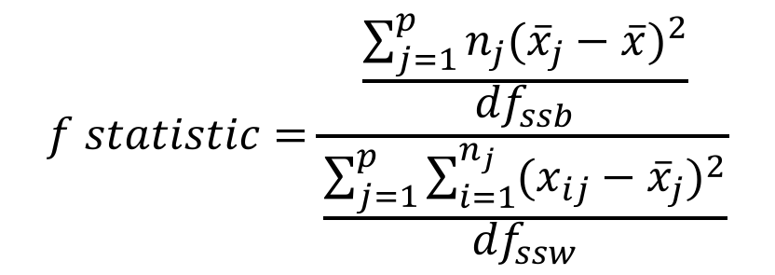
Analysis of Variance
A | B | C
2 | 5 | 7
2 | 8 | 4
3 | 8 | 5
5 | 7 | 4
$$f statistic=\frac{\frac{\sum_{j=1}^{p}{n_{j}{({\overline{x}}_{j}−\overline{x})}^{2}}}{{df}_{ssb}}}{\frac{\sum_{j=1}^{p}{\sum_{i=1}^{n_{j}}{{(x_{ij}−{\overline{x}}_{j})}^{2}}}}{{df}_{ssw}}}$$

Slide 24
Analysis of Variance
A | B | C
2 | 5 | 7
2 | 8 | 4
3 | 8 | 5
5 | 7 | 4
$$f statistic=\frac{\frac{\sum_{j=1}^{p}{n_{j}{({\overline{x}}_{j}−\overline{x})}^{2}}}{{df}_{ssb}}}{\frac{\sum_{j=1}^{p}{\sum_{i=1}^{n_{j}}{{(x_{ij}−{\overline{x}}_{j})}^{2}}}}{{df}_{ssw}}}$$

Slide 25
Analysis of Variance
A | B | C
2 | 5 | 7
2 | 8 | 4
3 | 8 | 5
5 | 7 | 4
$$f statistic=\frac{\frac{\sum_{j=1}^{p}{n_{j}{({\overline{x}}_{j}−\overline{x})}^{2}}}{{df}_{ssb}}}{\frac{\sum_{j=1}^{p}{\sum_{i=1}^{n_{j}}{{(x_{ij}−{\overline{x}}_{j})}^{2}}}}{{df}_{ssw}}}$$

Slide 26
Analysis of Variance
A | B | C
2 | 5 | 7
2 | 8 | 4
3 | 8 | 5
5 | 7 | 4
$$f statistic=\frac{\frac{\sum_{j=1}^{p}{n_{j}{({\overline{x}}_{j}−\overline{x})}^{2}}}{{df}_{ssb}}}{\frac{\sum_{j=1}^{p}{\sum_{i=1}^{n_{j}}{{(x_{ij}−{\overline{x}}_{j})}^{2}}}}{{df}_{ssw}}}$$

Slide 27
Analysis of Variance
A | B | C
2 | 5 | 7
2 | 8 | 4
3 | 8 | 5
5 | 7 | 4
$$f statistic=\frac{\frac{\sum_{j=1}^{p}{n_{j}{({\overline{x}}_{j}−\overline{x})}^{2}}}{{df}_{ssb}}}{\frac{\sum_{j=1}^{p}{\sum_{i=1}^{n_{j}}{{(x_{ij}−{\overline{x}}_{j})}^{2}}}}{{df}_{ssw}}}$$

Slide 28
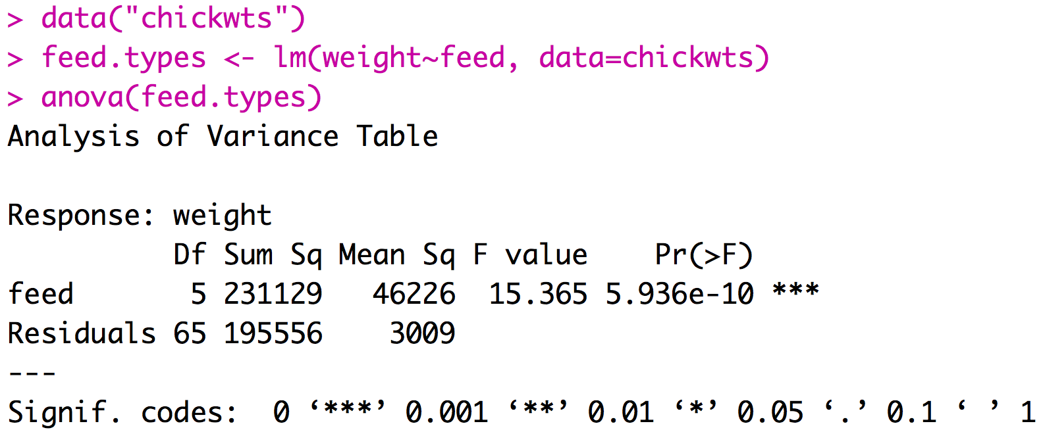
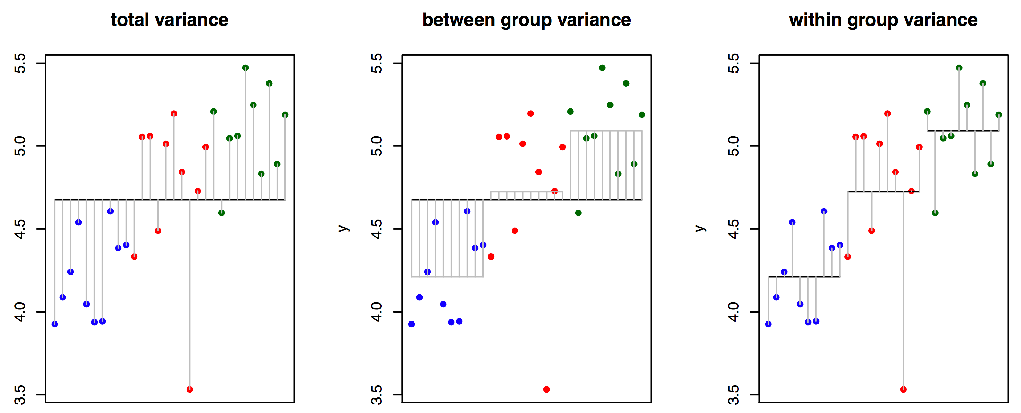
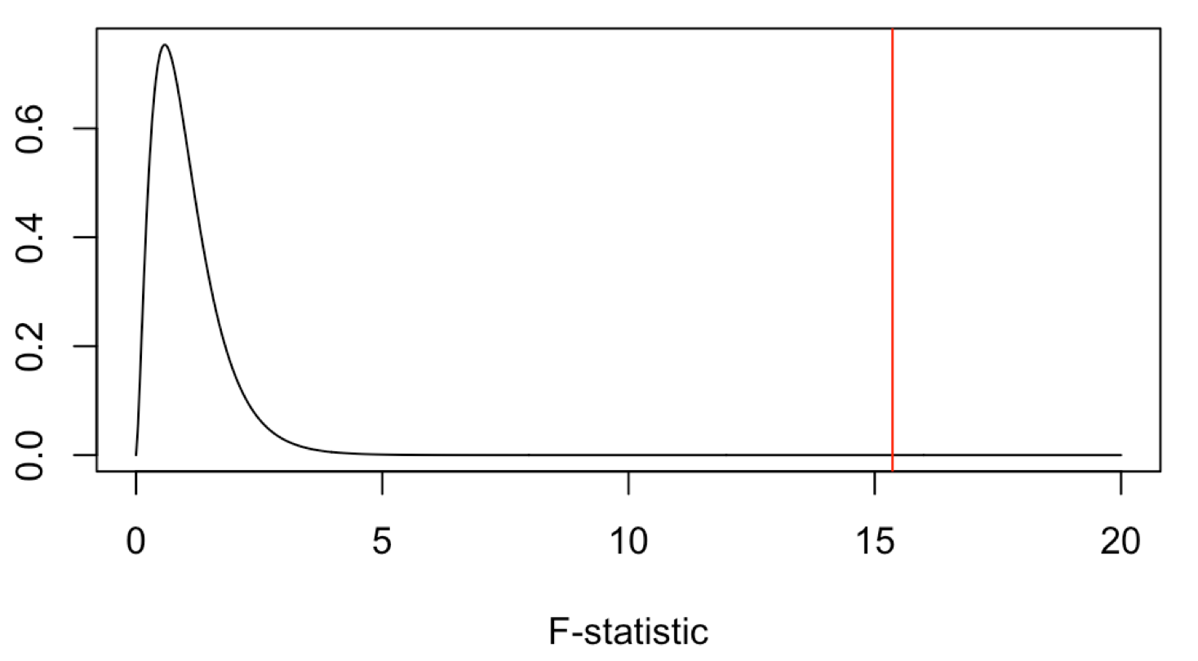
Running ANOVA in R
This significant result tells us that at least one of the groups of chickens have significantly different mean weights than other groups. (significant ANOVA result allows us to reject the null that they are all the same)

Slide 29
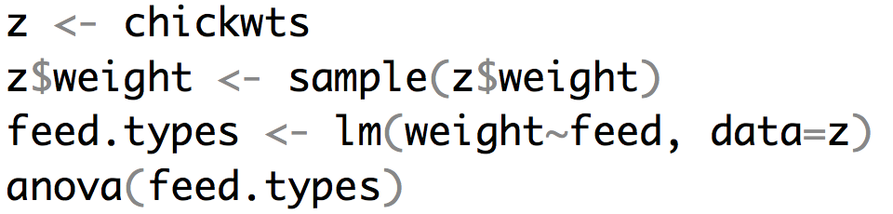
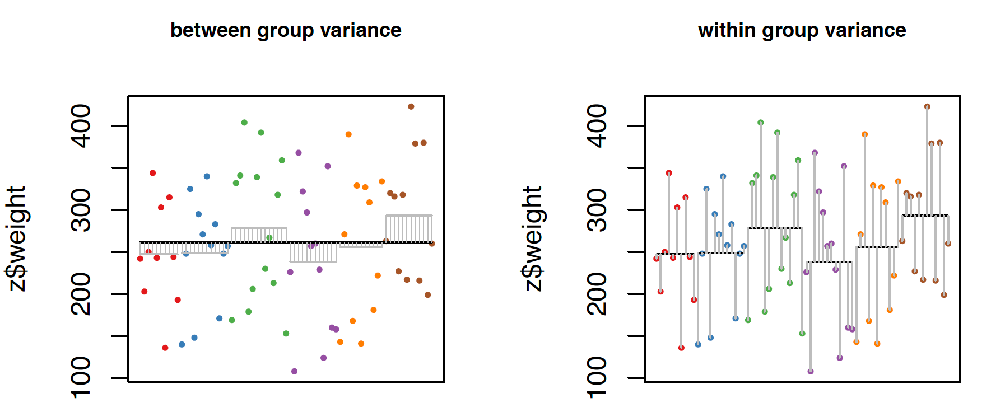
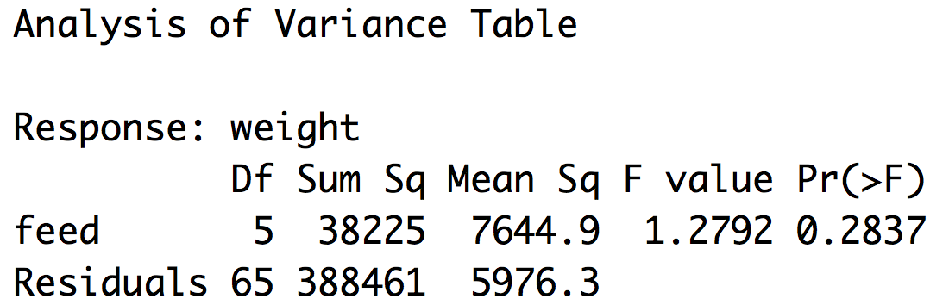
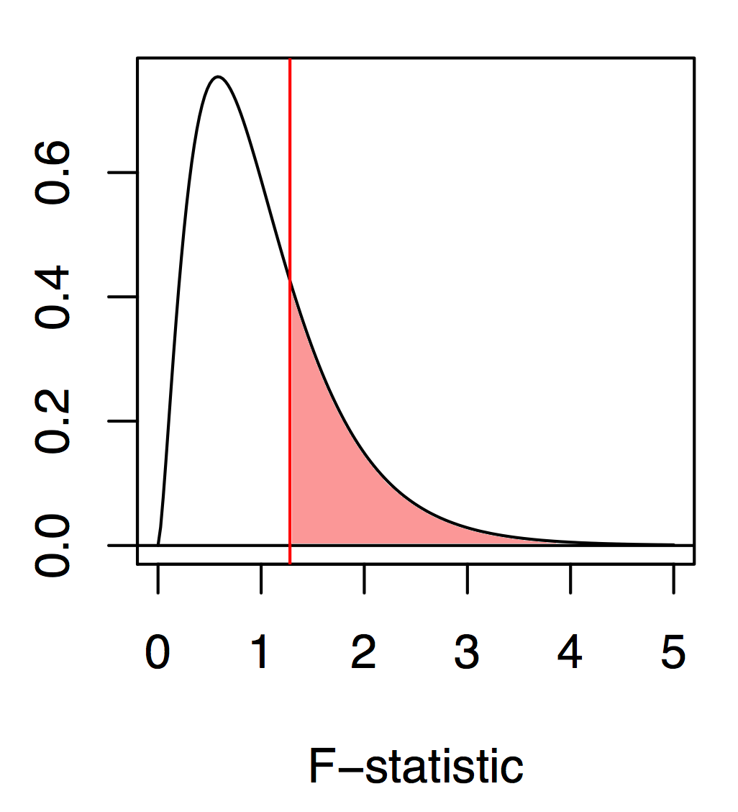
Running ANOVA in R

Slide 30
Post-hoc tests
If your ANOVA is significant, you may be interested in discovering which groups are different from one another
A variety of post-hoc comparisons of the means can be used
Fisher’s LSD
Least conservative test, basically uses t-tests to compare the means
Scheffe’s method
Performs all comparisons simultaneously, but has relatively low power
Tukey-Kramer method
A pair-wise method, like a t-test, but corrected for multiple comparisons

Slide 31
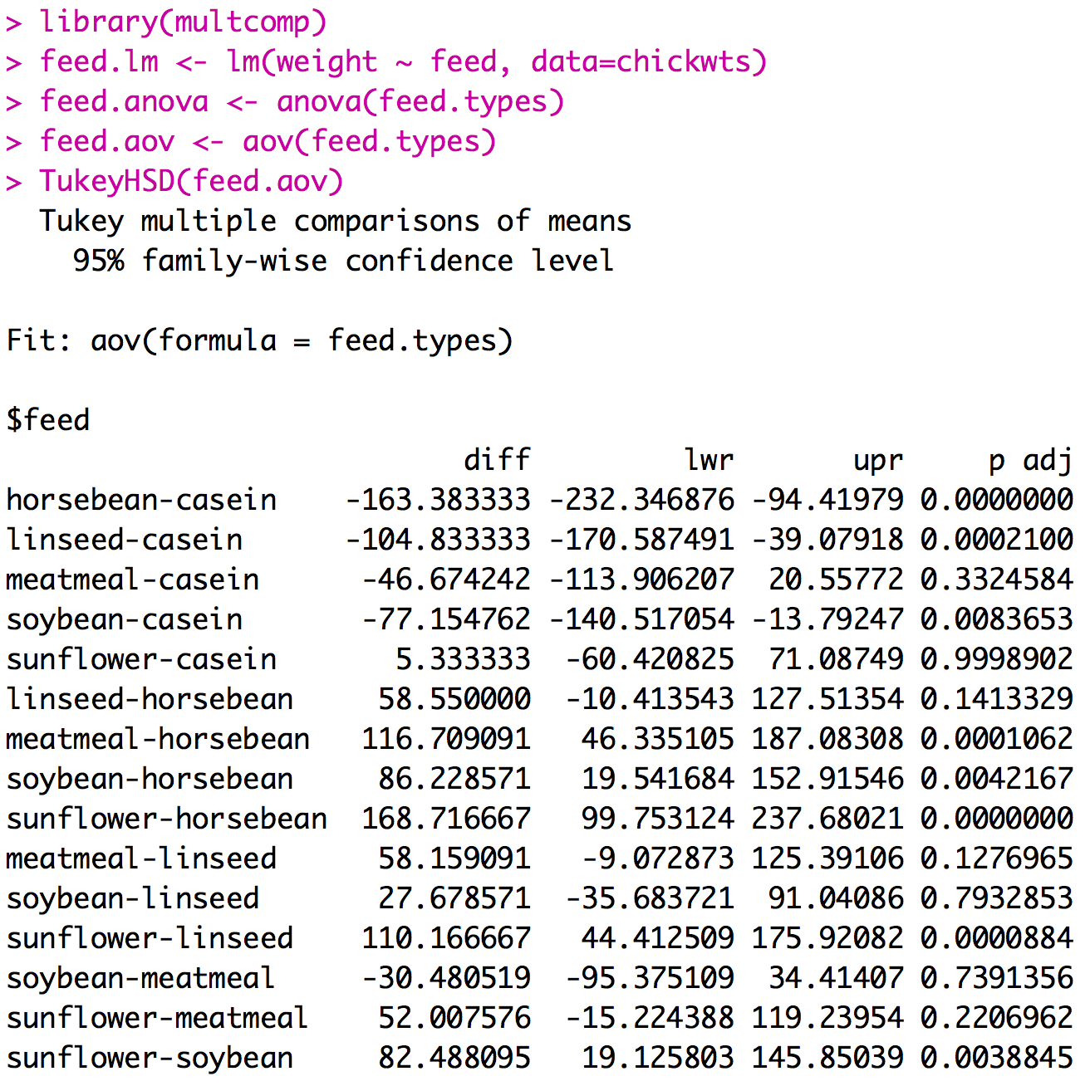
Post-hoc tests
anova and aov functions will both perform an ANOVA but the results are stored slightly differently. For this posthoc test we want the aov format

Slide 32
Interpreting post-hoc tests
When we examine all the significantly different ones we can draw several conclusions:
Chicks fed casein are significantly heavier than those fed horsebean, linseed, and soybean.
Chicks fed horsebean are significantly lighter than those fed meatmeal, soybean, and sunflower.
Chicks fed sunflower are significantly heavier than those fed linseed or soybean.

Slide 33
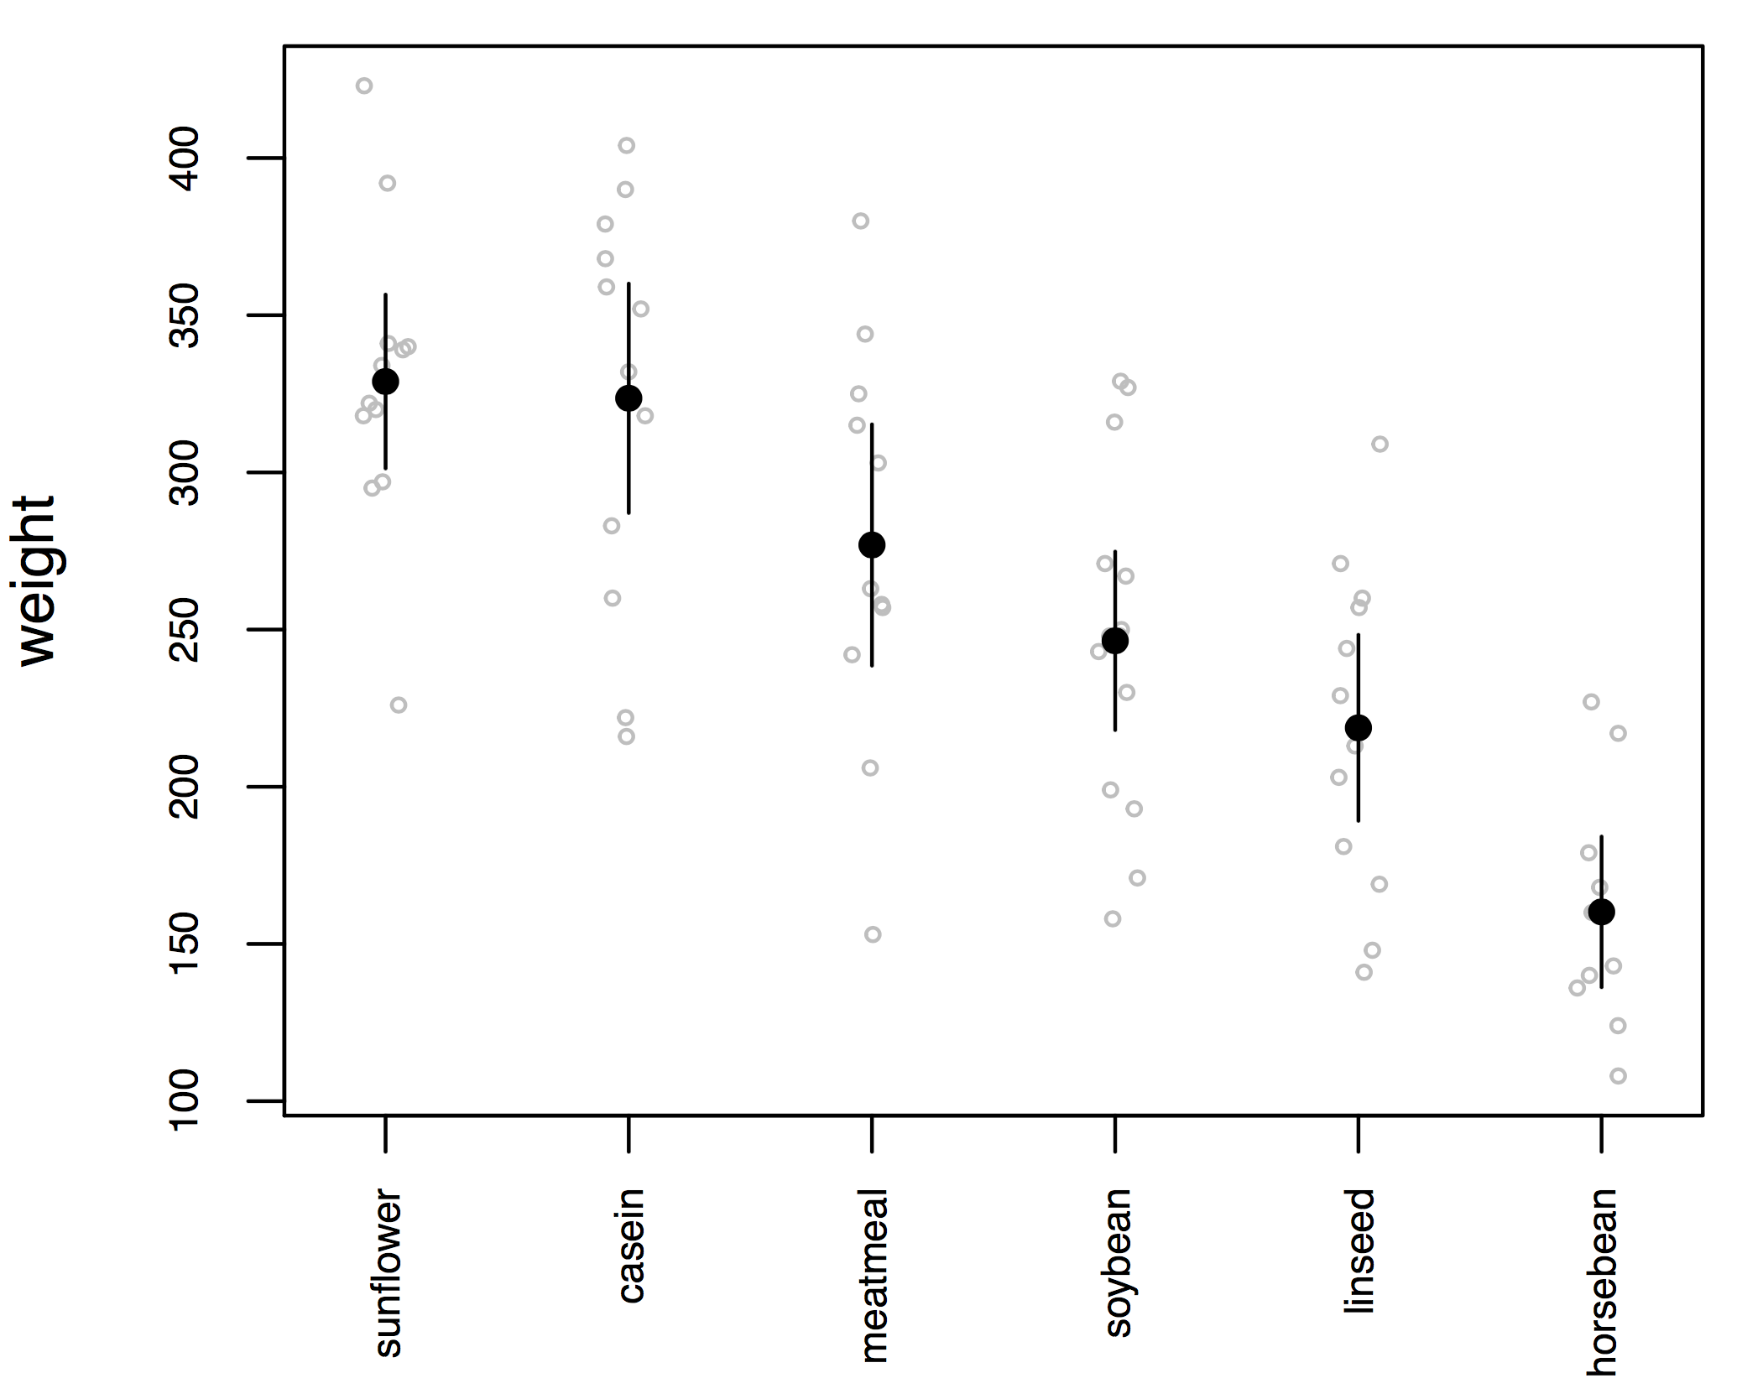
Plotting this kind of data
Our results from the ANOVA and Tukey match up pretty well with our rules of thumb about 95% CI overlaps

Slide 34
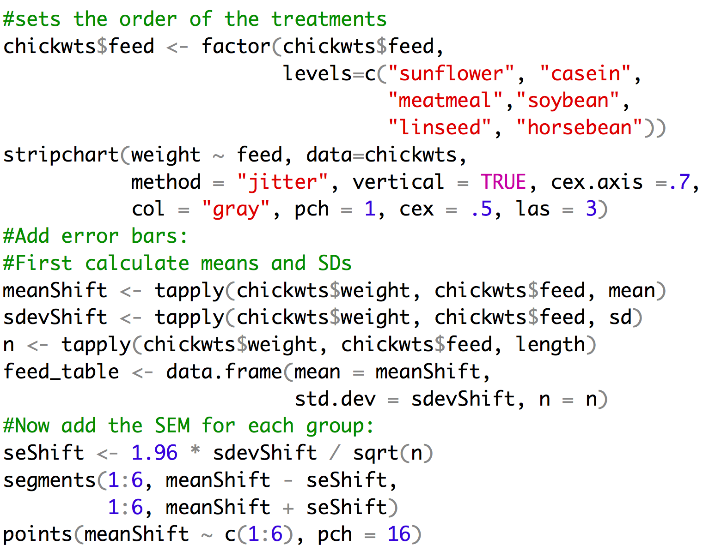
Example of code

Slide 35
Assumptions of the ANOVA
The variable is normally distributed within each group
The variance is the same in the different groups
The design is balanced – you have the same sample size for each group
But… ANOVA is fairly robust to violations of these assumptions

Slide 36
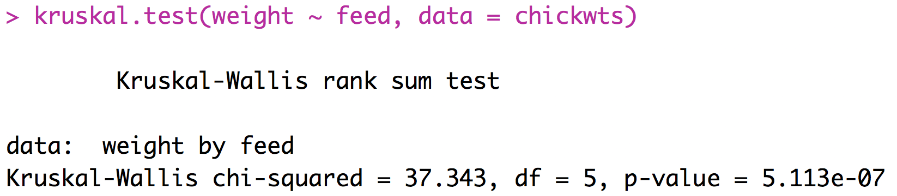
A Non-Parametric Alternative
Kruskal-Wallis Test
Based on ranks
The multiple-group version of the Mann-Whitney U-test
R-implementation:
p-value suggests this
test has lower power
than ANOVA

Slide 37
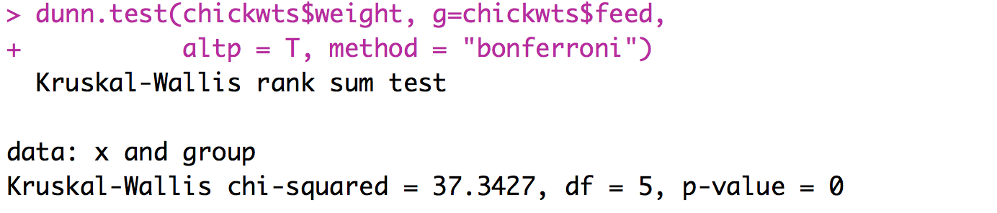
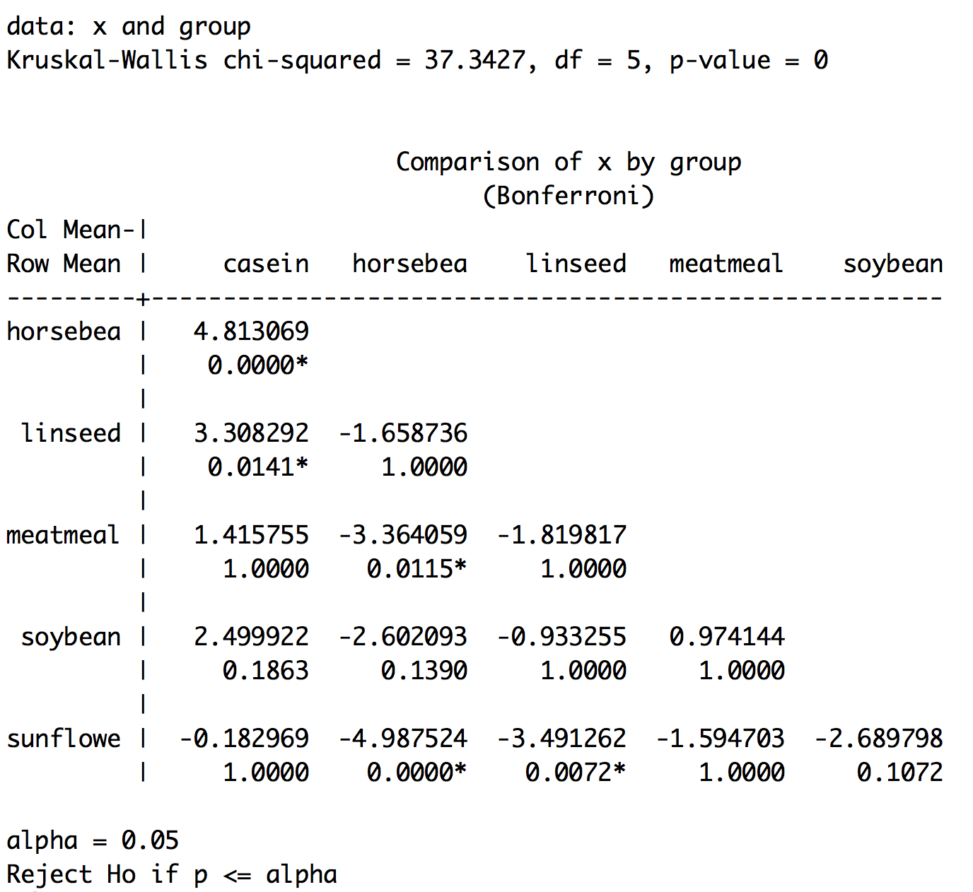
A Non-Parametric post-hoc
Dunn’s test – is the non-parametric equivalent of the Tukey
Not in base R need to install:
install.packages(“dunn.test”, dependencies=TRUE)

Slide 38
ANOVA Summary
ANOVA is the foundation of essentially all tests comparing multiple means
Don’t make it too complicated – the null hypothesis is simple: they are all the same.
Post-hoc tests are important for determining which means are the source of a significant ANOVA.
You can only justify a post-hoc test if the ANOVA is significant in the first place.
Before applying ANOVA, check that your data fit the assumptions (consider transforming the data lots of times this will be based on your biological knowledge because you will have insufficient data to say much about the observed distribution)

Slide 39
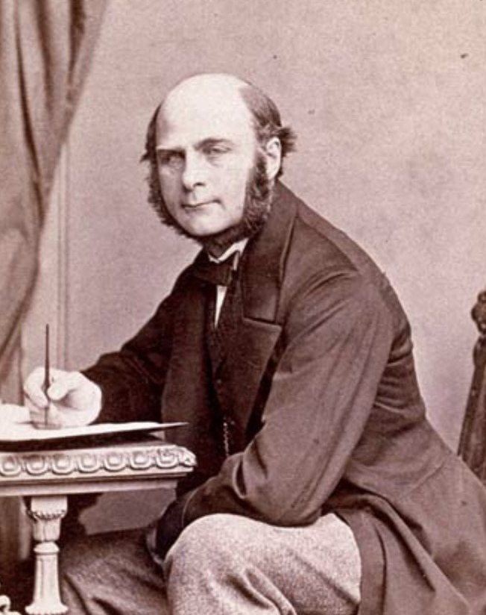
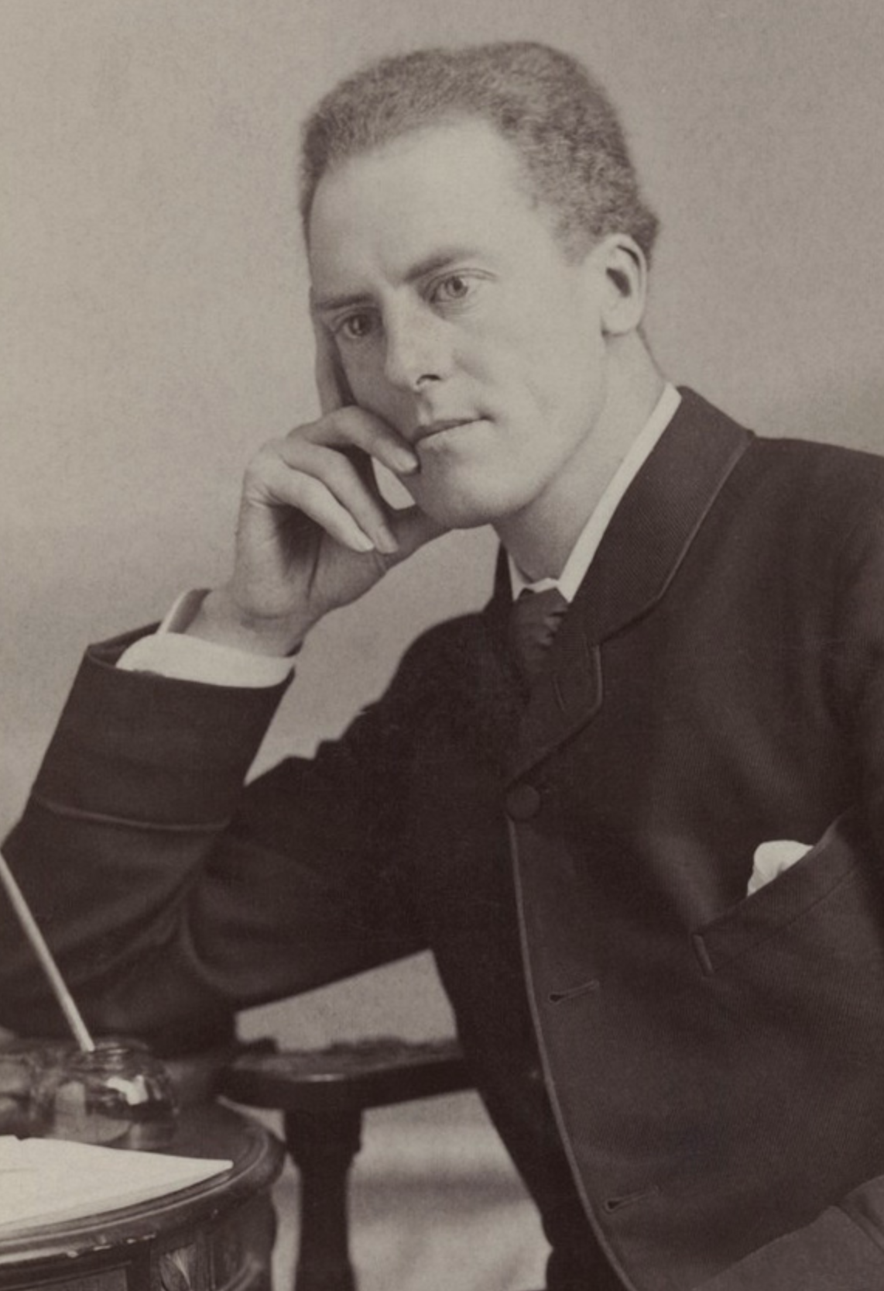
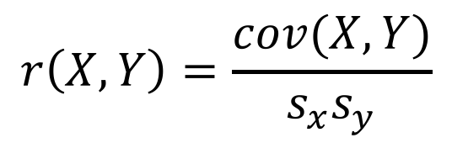
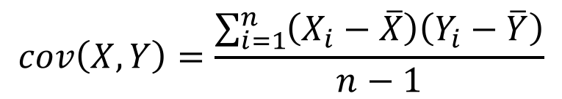
Correlation and Causation
The correlation is a foundational concept in the biological sciences
Pearson’s correlation coefficient:
$$r\left(X,Y\right)=\frac{cov(X,Y)}{s_{x}s_{y}}$$
Francis Galton
1822 - 1911
Karl Pearson
1857 - 1936
$$cov\left(X,Y\right)=\frac{\sum_{i=1}^{n}{\left(X_{i}−\overline{X}\right)\left(Y_{i}−\overline{Y}\right)}}{n−1}$$
Notes:
Galton invented term eugenics cousins with darwin mention regression to the mean
Pearson invented modern concept of and widely applied to r. Also eugenicist and racist

Slide 40
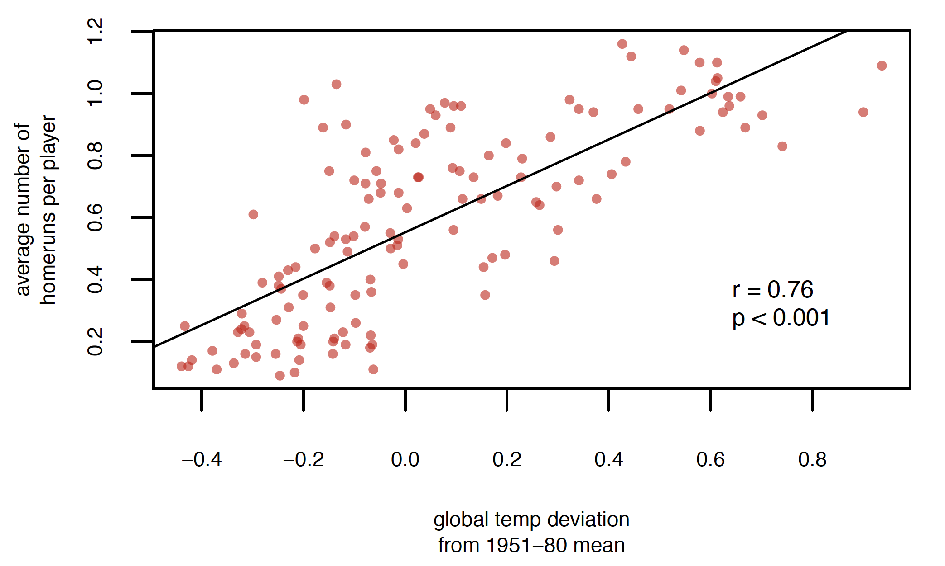
Covariance and Correlation

Slide 41
Covariance and Correlation
Average number of
home runs per game

Slide 42
Pearson’s Correlation Coefficient
Assumes that the data are roughly from a bivariate normal distribution
Would not be appropriate when:
Relationship is non-linear (possible solutions?)
Dataset contains extreme outliers (evaluate leverage)
Data are in multiple distinct clouds of points (what could cause this?)

Slide 43
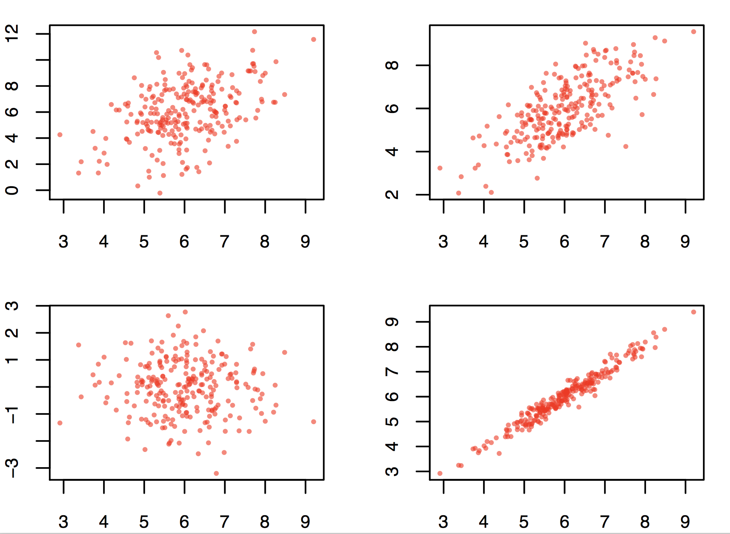
Good data

Slide 44
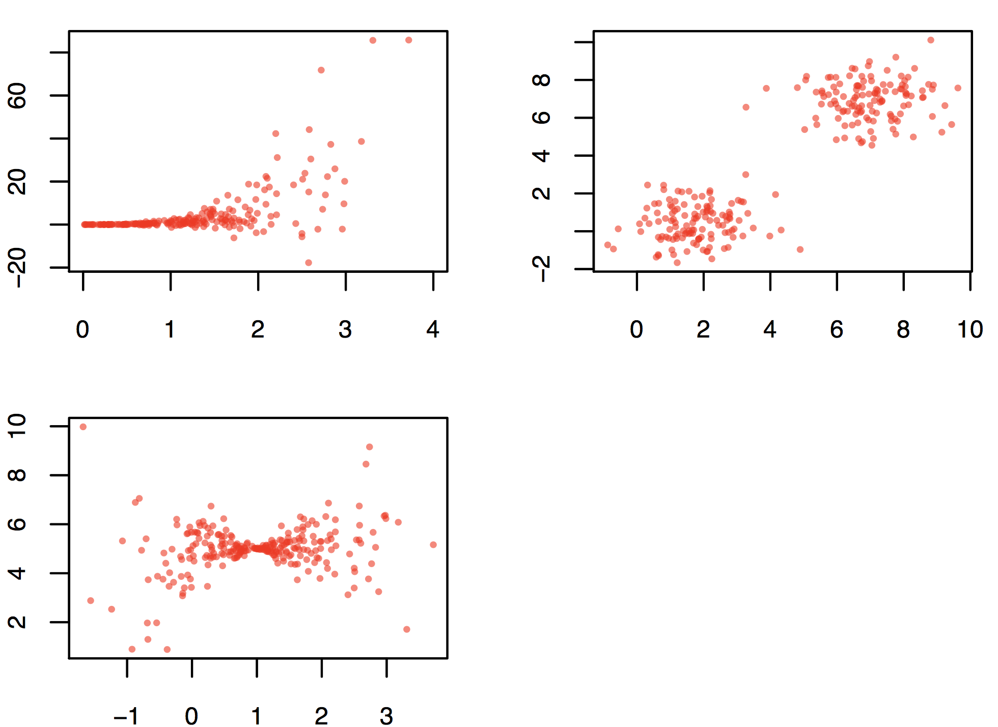
Bad data

Slide 45
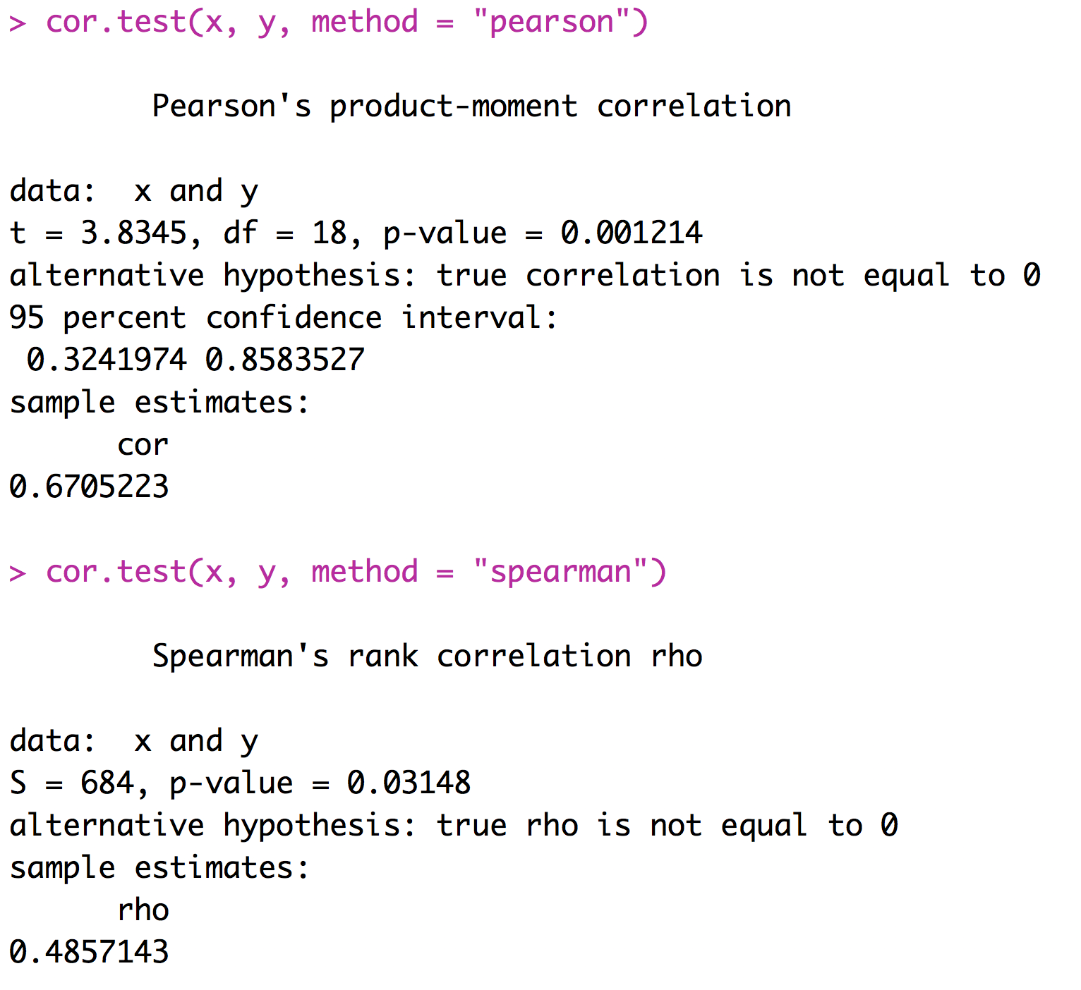
Spearman’s Rank Correlation
An alternative to Pearson’s correlation coefficient for data that depart substantially from bivariate normality
Based on ranks

Slide 46
Correlation Summary
Correlations are very important
We are interested in correlations between values of treatments and response variables
We are interested in correlations between various factors that could affect the response variable
We need to think about correlations between explanatory variables and potentially confounding variables
Many types of experiments call for the calculation and consideration of correlation coefficients

Slide 47
For Thursday
Read chapter WS 14-16
Bring laptop to class!
Heath Blackmon
BSBW 309
coleoguy@gmail.com
@coleoguy

